Slide 1
Comparison of Multivariate Time Series Prediction Techniques for Emulating Noah-LSM Soil Moisture Outputs
Mitchell Dodson^{1,2}, Dr. Christopher Hain²
¹University of Alabama in Huntsville
²NASA Short-term Prediction Research and Transition Center

Slide 2
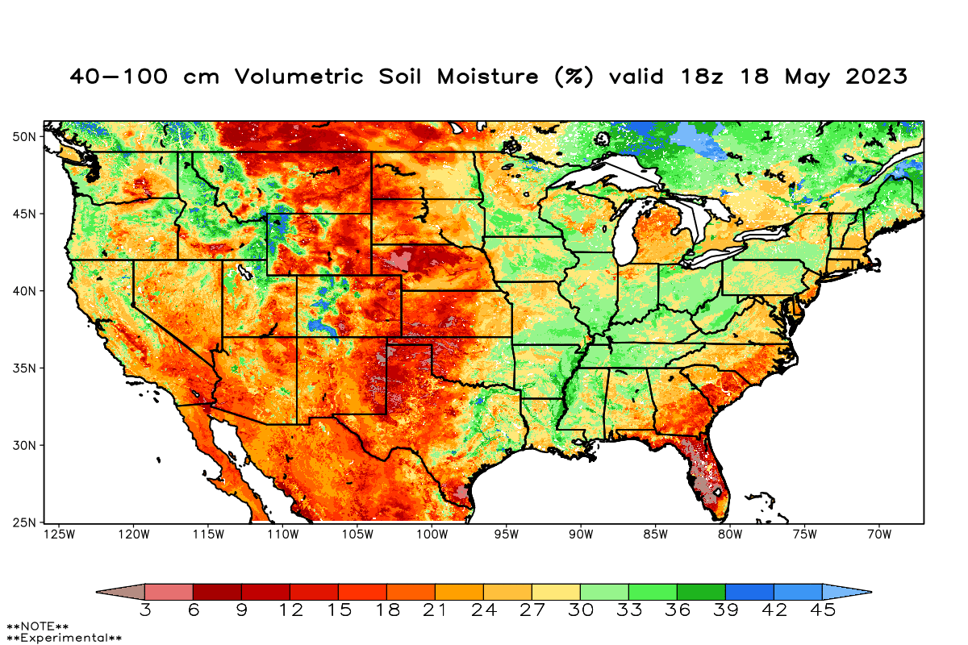
High-resolution soil moisture is useful, but expensive
SPoRT provides hourly near real-time forecasts and short-term retrospective soil moisture estimates over CONUS on a 3km grid, using the Noah Land Surface Model within the LIS framework.
End-users include the US Drought Monitor and NOAA/NWS.
High-resolution gridded soil moisture diagnosis is important for situational awareness preceding drought and flood events, and for initializing weather and climate models.
However, the compute cost of running the model at finer spatial resolutions can be prohibitive, especially for executing ensemble forecasts at multiple temporal horizons.
SPoRT-LIS Soil Moisture Grid
SPoRT-LIS Forecast → Climatology Timeline
Climatology
Near Real-Time
Forecast
(NLDAS)
(GDAS, MRMS)
(GFS)
Jan 1, 1981
t-4d
t (present)
t+14d
Notes:
SPoRT generates a series of data products including Noah-LSM soil moisture outputs on a 3km grid over CONUS
Product is released at an hourly resolution twice per day in the 3-cycle paradigm forced by
GFS outlooks to 14 days
GDAS and precip from MRMS
NLDAS, forming a 40+ year climatology.
High-res forecasts of soil moisture states are important for initializing NWP/climate models and for near-term situational awareness of drought and flood conditions.
Computational cost of executing the model can be prohibitive for using ensemble forcings for forecasting land surface states.
This is especially true for the upcoming advent of NLDAS-3, which increases the number of land surface points from about 76,000 to 27.2 million

Slide 3
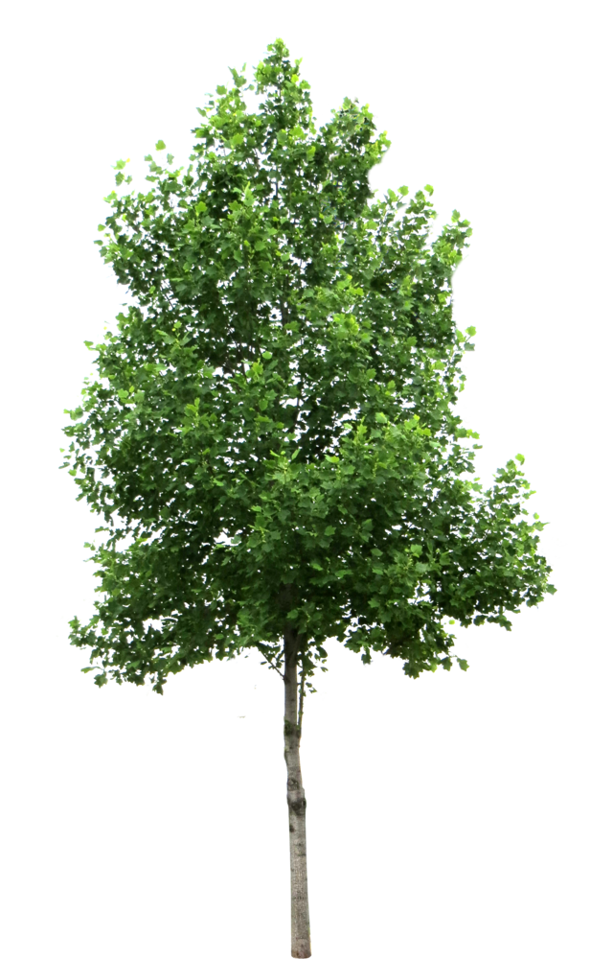
Input Features and Predicted Variables
Dynamic Features: NLDAS-2 Forcings
Hourly precip total (kg/m²)
CAPE (J/kg)
Downward longwave flux (W/m²)
Downward shortwave flux (W/m²)
Hourly potential evaporation (kg/m²)
Pressure 2m AGL (Pa)
Specific humidity 2m AGL (kg/kg)
Temperature 2m AGL (K)
Wind speed (m/s)
Green vegetation (monthly) (%)
Leaf area index (monthly)
Predicted: NLDAS-2 run of Noah-LSM
Soil moisture 0-10cm (kg/m³)
Soil moisture 10-40cm (kg/m³)
Soil moisture 40-100cm (kg/m³)
Soil moisture 100-200cm (kg/m³)
interception
transpiration
canopy evaporation
precipitation,
condensation
sfc runoff
Infiltration
Static Features:
GTOPO30 Elevation (m)
GTOPO30 Stdev. Elevation (m)
UMD Vegetation type unitless
STATSGO Sand percentage (%)
STATSGO Silt percentage (%)
STATSGO Clay percentage (%)
direct evaporation
root uptake
vertical moisture flux
sub-surface runoff
Notes:
These are inputs used to train the following models, and a large subset of those used to initialize the NLDAS-2 run of Noah-LSM.
Time varying features include atmospheric and radiative properties from NLDAS-2, as well as vegetation phenology (GVF and LAI)
Static features include elevation, soil texture, and vegetation class
Soil moisture outputs are separated into 4 discrete layers of different thicknesses.
Moisture sources include precip, condensation; sinks include surface and sub-surface runoff, as well as evapotranspiration
Vegetation parameters govern water intercepted by plant canopy, rate of plant transpiration
In Noah-LSM, moisture fluxes between layers are determined by a parameterization based on the Richards equation.

Slide 4
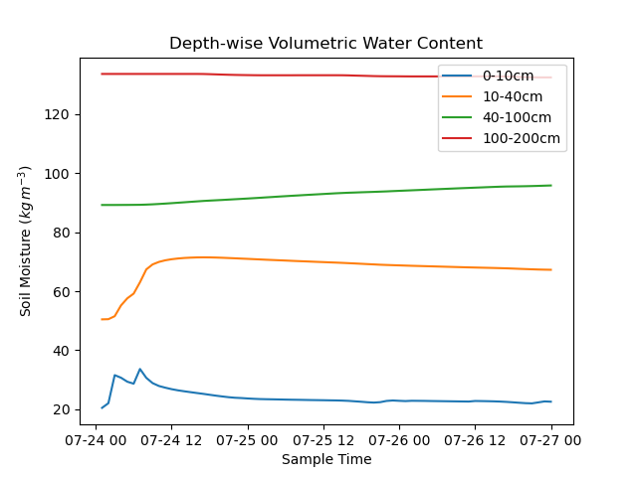
Input Features and Predicted Variables
Dynamic Features: NLDAS-2 Forcings
Hourly precip total (kg/m²)
CAPE (J/kg)
Downward longwave flux (W/m²)
Downward shortwave flux (W/m²)
Hourly potential evaporation (kg/m²)
Pressure 2m AGL (Pa)
Specific humidity 2m AGL (kg/kg)
Temperature 2m AGL (K)
Wind speed (m/s)
Green vegetation (monthly) (%)
Leaf area index (monthly)
Predicted: NLDAS-2 run of Noah-LSM
Soil moisture 0-10cm (kg/m³)
Soil moisture 10-40cm (kg/m³)
Soil moisture 40-100cm (kg/m³)
Soil moisture 100-200cm (kg/m³)
Static Features:
GTOPO30 Elevation (m)
GTOPO30 Stdev. Elevation (m)
UMD Vegetation type unitless
STATSGO Sand percentage (%)
STATSGO Silt percentage (%)
STATSGO Clay percentage (%)
Notes:
This is an example of the impact of a precipitation event on each depth level over a 72 hour period
The surface layer is subject to the largest number of feedbacks, responds quickly and very dynamically.
Lower layers are gradually recharged at a rate proportional to their depth and thickness.
Important takeaway is that each layer responds to forcings and adjacent layer states at very different timescales.
Also note that Noah-LSM has separate parameterizations for cold season processes; no distinction is explicitly made in my modeling

Slide 5
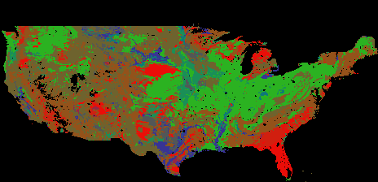
Dataset and Training Procedure
Each of the following models were trained on all CONUS pixels in the NLDAS-2 grid, except those classified as bare or urban surfaces by STATSGO.
Training period includes 2015, 2017, 2019, 2021, and 2022; a total of 92,846,875 points
Divide all valid pixels into continuous 72h time segments; extract and shuffle all the samples as 3d arrays shaped like (time step, segment element, feature).
Linearly scale all feature values to conform to a normalized gaussian.
At training time, pick a random time of day as t₀ for each sample; extract a 12h past “window,” and a 12h future “horizon” starting with t₀.
Optimize for minimum RMSE at all depths, stopping when validation loss flatlines.
Train multiple model shapes and hyperparameter configurations and select the most performant.
Soil texture map over valid domain
12h window
12h horizon
0h
t₀-12h
t₀
t₀+11h
72h
Notes:
Training period includes 5 full years, validation and testing data are drawn from 2 years (2016 and 2018)
During data prep, time series are partitioned into non-overlapping continuous 72h time segments to avoid contamination by interdependent training samples.
Samples are normalized to conform to a gaussian with mean=0 and stdev=1 and are thoroughly shuffled.
At training time, a random time of day is selected as the “present”.
12h of ”past” data are returned as a “window” to initialize the model.
12h of “future” data are returned as a “horizon” separated into covariate input forcings and truth labels
Used Adam to optimize for RMSE of soil moisture values at all depth levels simultaneously.
At each stage, trained multiple models while varying hyperparameters like layer count, node count, learning rate, activation function, regularization type.

Slide 6
Feed-forward next-step predictor
The feed-forward model is the simplest, consisting of only fully-connected layers with dropout and batch normalization.
Input features include only the previous timestep, static parameters, and a single forecast horizon.
This mimics the Noah Land Surface Model in that each new soil moisture diagnosis is only informed by the previous state and current forcings.
X_{t-1}
Y_{t-1}
X_{t}
S
Feed-Forward
Y_{t}
Tested model depths between 2 and 8 layers, and total parameter counts between 70,000-2,140,000.
The most skillful model had 6 layers with 544,132 parameters, and a 1% dropout rate.
[Y_{t-1}]
[Y_{t}]
[Y_{t+1}]
[Y_{t+2}]
[Y_{t+3}]
FF
FF
FF
FF
[X_{t-1}]
[S, X_{t}]
[S, X_{t+1}]
[S, X_{t+2}]
[S, X_{t+3}]
Notes:
Feed-forward architecture consists only of densely-connected layers, which only recieve
atmospheric forcings and soil states from the previous timestep (X_{t-1} and Y_{t-1})
atmospheric forcings from the current timestep (X_{t})
static data (S)
No internal context is stored by the model and passed between timesteps; only the prediction outputs.

Slide 7
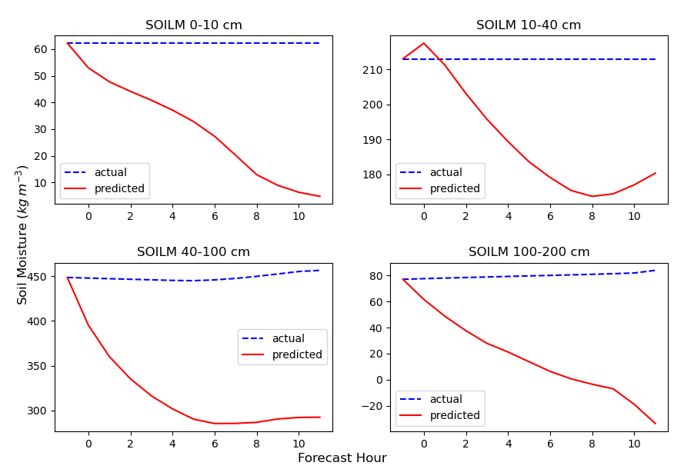
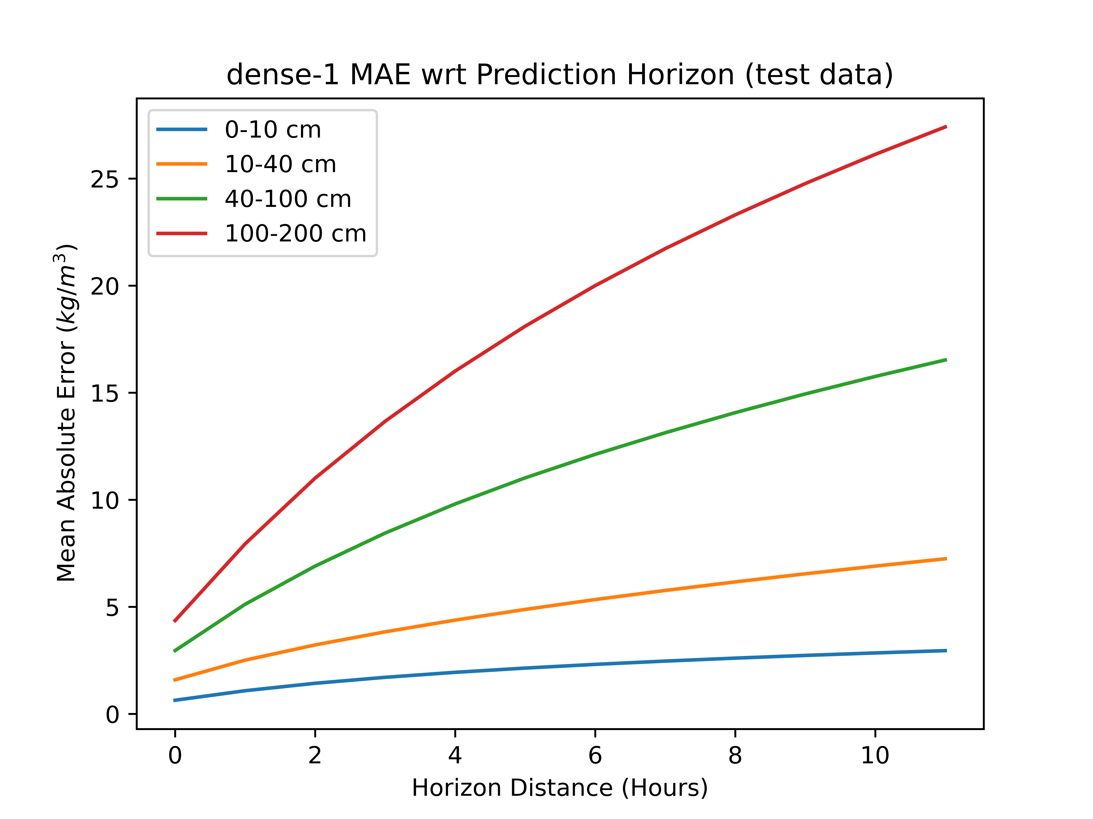
Results from feed-forward next-step predictor
Bulk statistics show that the simple feed-forward architecture accumulates prediction error as the forecast horizon increases.
Furthermore, predicted values over the 2-year testing dataset have an irregular distribution with multiple peaks not conforming to the actual distribution.
Notes:
Somewhat unsurprisingly, prediction error at each timestep has a tendancy to compound and cause results to rapidly diverge from actual values.
Left: typical example of divergence of predictions with a 12 hour horizon.
Right: overall average MAE at each prediction horizon shows the effect of error accumulation

Slide 8
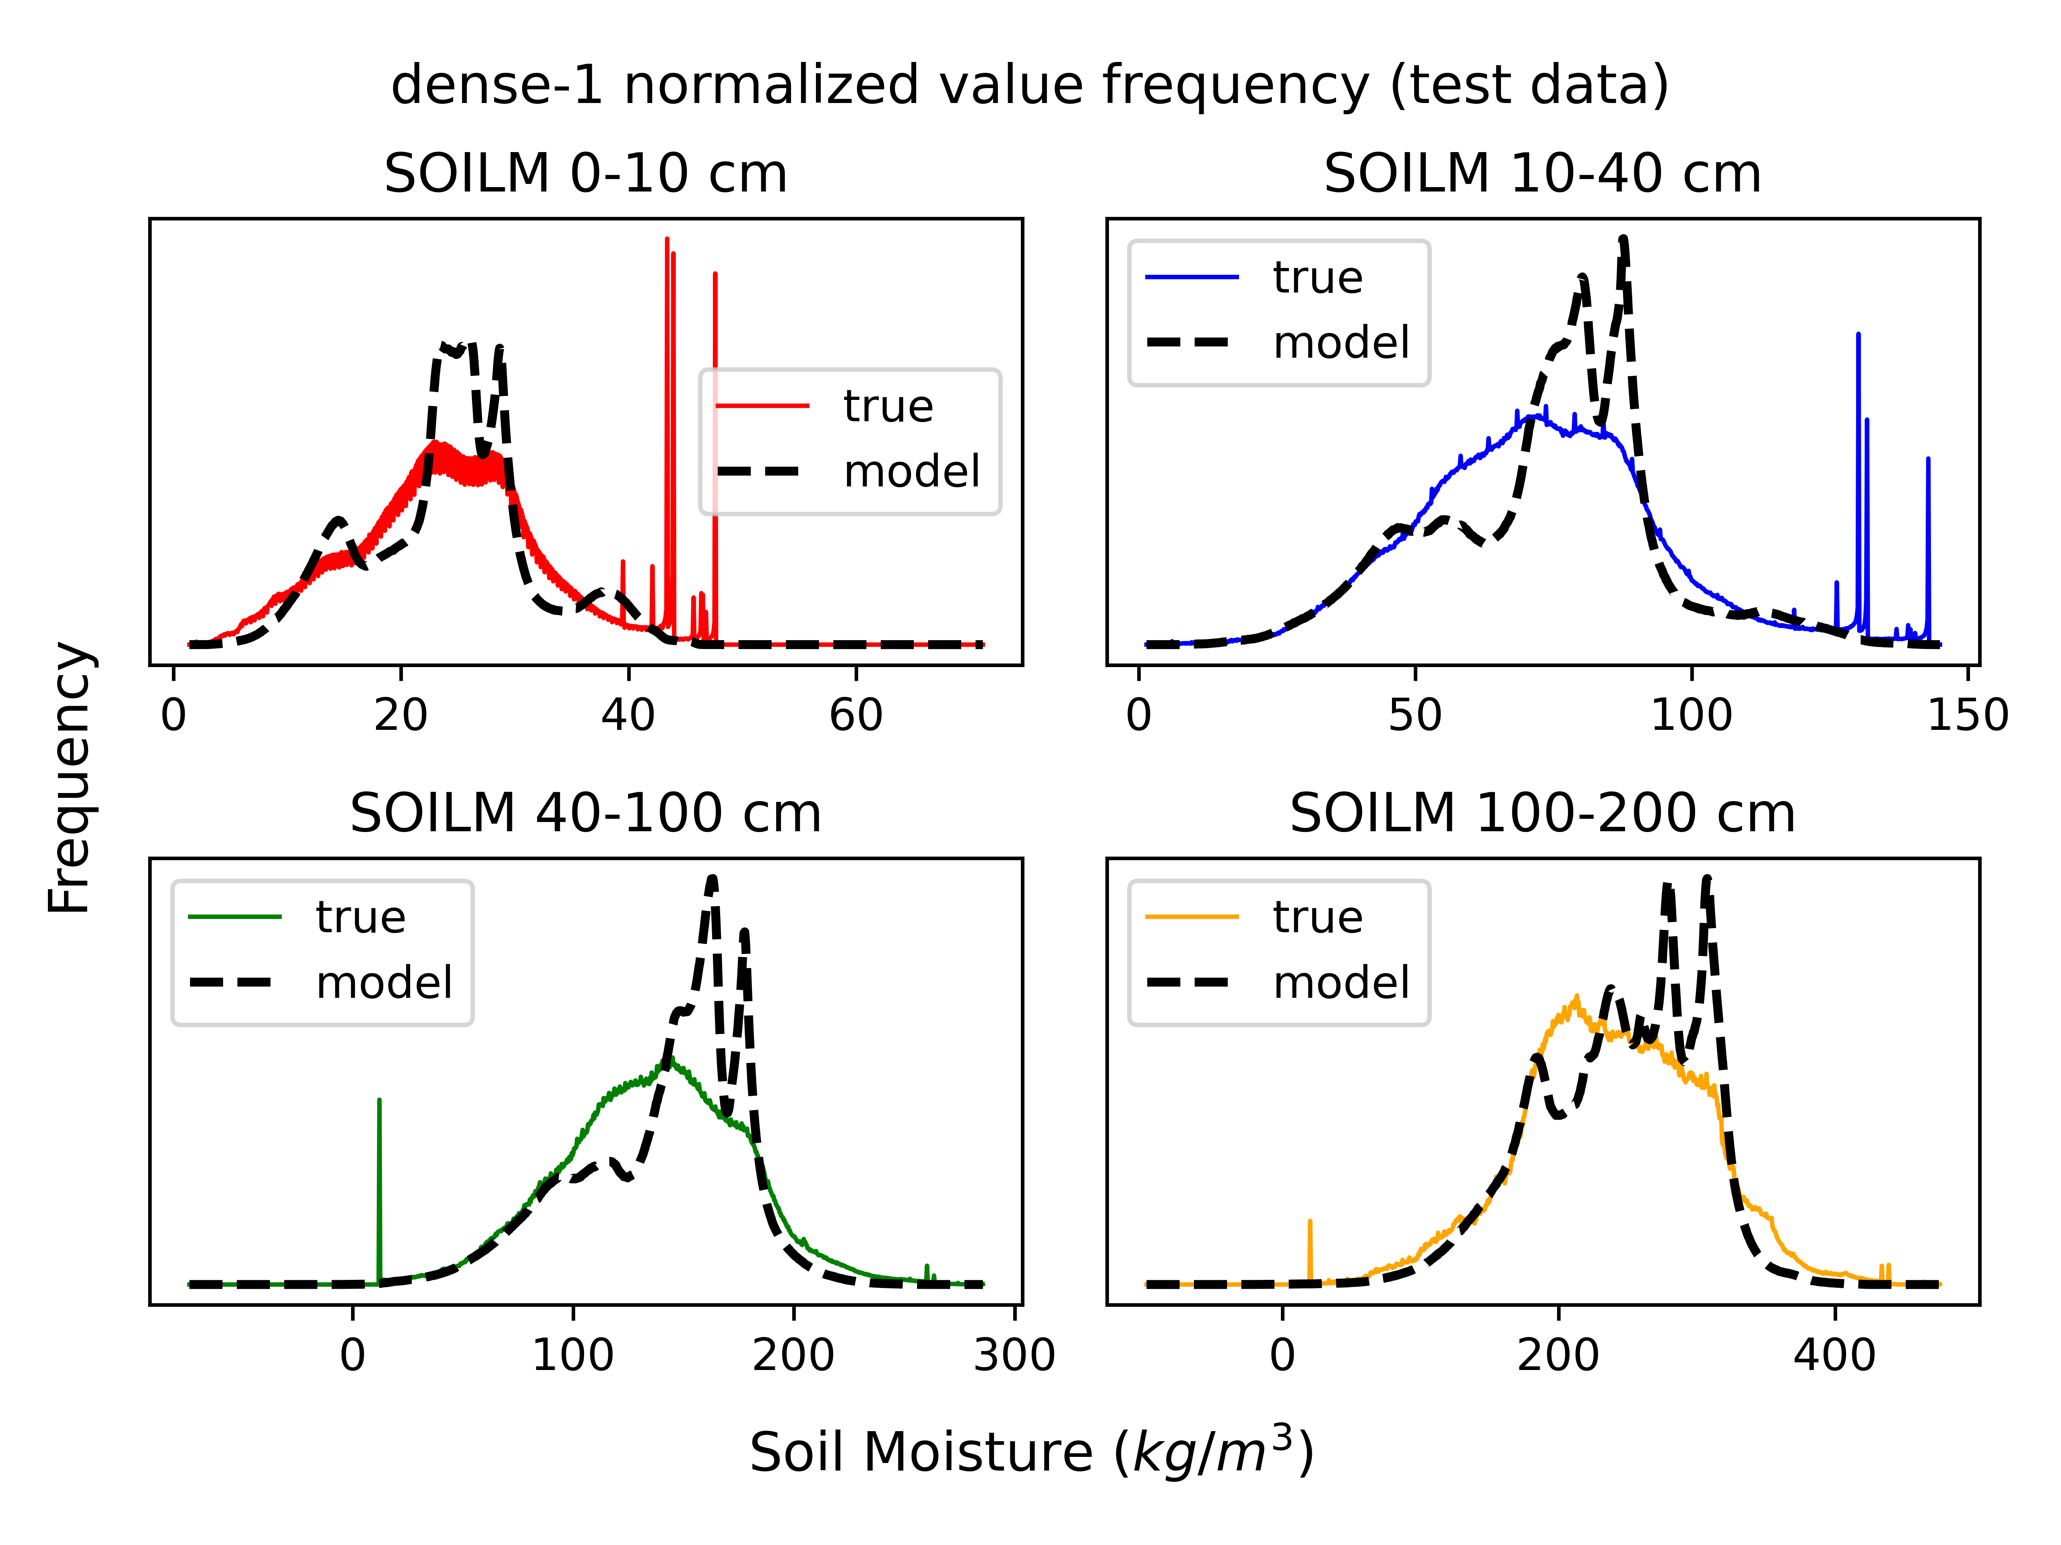
Results from next-step predictors
Bulk statistics show that the simple feed-forward architecture accumulates prediction error as the forecast horizon increases.
Furthermore, predicted values over the 2-year testing dataset have an irregular distribution with multiple peaks not conforming to the actual distribution.
Notes:
1. Value distributions at each depth level tend to capture the overall range and mean values, but have several peaks.

Slide 9
The LSTM architecture
LSTM models addresses the exploding/vanishing gradient problems using gates with learned weights, which maintain and retrieve information from a context vector C. Each LSTM cell in a sequence shares the same learned parameters.
The context C (cell state) is passed between cells in the sequence, and never directly operated on by a weights matrix, which makes it less prone to error accumulation, and facilitates the exchange of information throughout longer input sequences.
y_{t}
The Forget Gate (1) modifies the previous context C_{t-1} by scaling it elementwise by σ layer activations (values in [0,1]).
The Update Gate (2) adds or subtracts to the context using both tanh and σ learned activations (values in [-1,1]).
The Output Gate (3) uses the scaled context vector and a learned σ layer to produce the output h_{t} (values in [-1,1]).
C_{t-1}
✖
➕
C_{t}
tanh
✖
✖
(1)
(2)
(3)
σ
tanh
σ
σ
h_{t-1}
h_{t}
x_{t}
Notes:
LSTM architectures facilitate the retention of information across sequence steps by managing a hidden context vector (C_{t}) passed between cells.
Context vector is kept stable by never being directly subjected to a learned matrix transform, instead modified only by multiplied and added coefficients determined by 4 learned information gates which depend on inputs.
Forget gate emphasizes or diminishes context activations by multiplication ; update gate adds or subtracts from context vector, and output gate scales the context vector to generate the cell’s output.

Slide 10
LSTM next-step predictor
The lack of an extended input sequence in the feed-forward approach may limit the network’s ability to learn temporal patterns of soil moisture dynamics.
The next-step predictor approach initializes the model with a 12-hour window of past forcings and soil moisture states, followed by a dense layer generating each output.
Similar to the feed-forward model, past outputs are cycled back into subsequent inputs.
LSTM Next-step Predictor
Y_{t}
Y_{t+1}
Y_{t+2}
NSP
LSTM
LSTM
LSTM
D
NSP
NSP
LSTM
LSTM
LSTM
S
S
[X,Y]_{t+1}
[X,Y]_{t+2}
[X,Y]_{t-w}
[X,Y]_{t-w+1}
[X,Y]_{t}
S
Notes:
LSTM next-step predictor recieves a 12-hour window of land surface states and atmospheric forcings as an input, and predicts only the following timestep.
Longer input hopefully facilitates inference from more abstract properties like current dry-down rate and soil saturation.
LSTM chain is followed by a dense layer which produces the output.
Attempted treating static data as an input at each timestep as well as only an input to the final dense layer; no significant difference between the two.

Slide 11
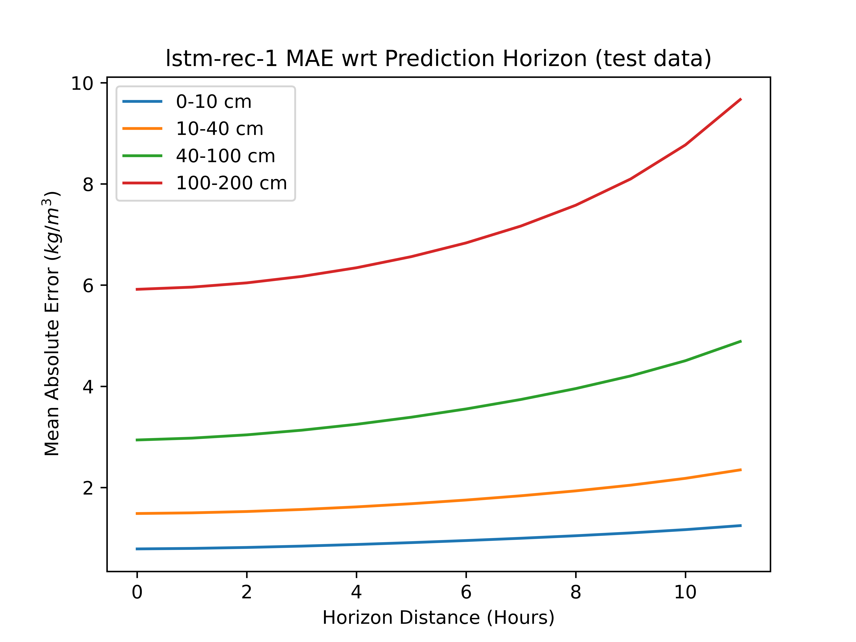
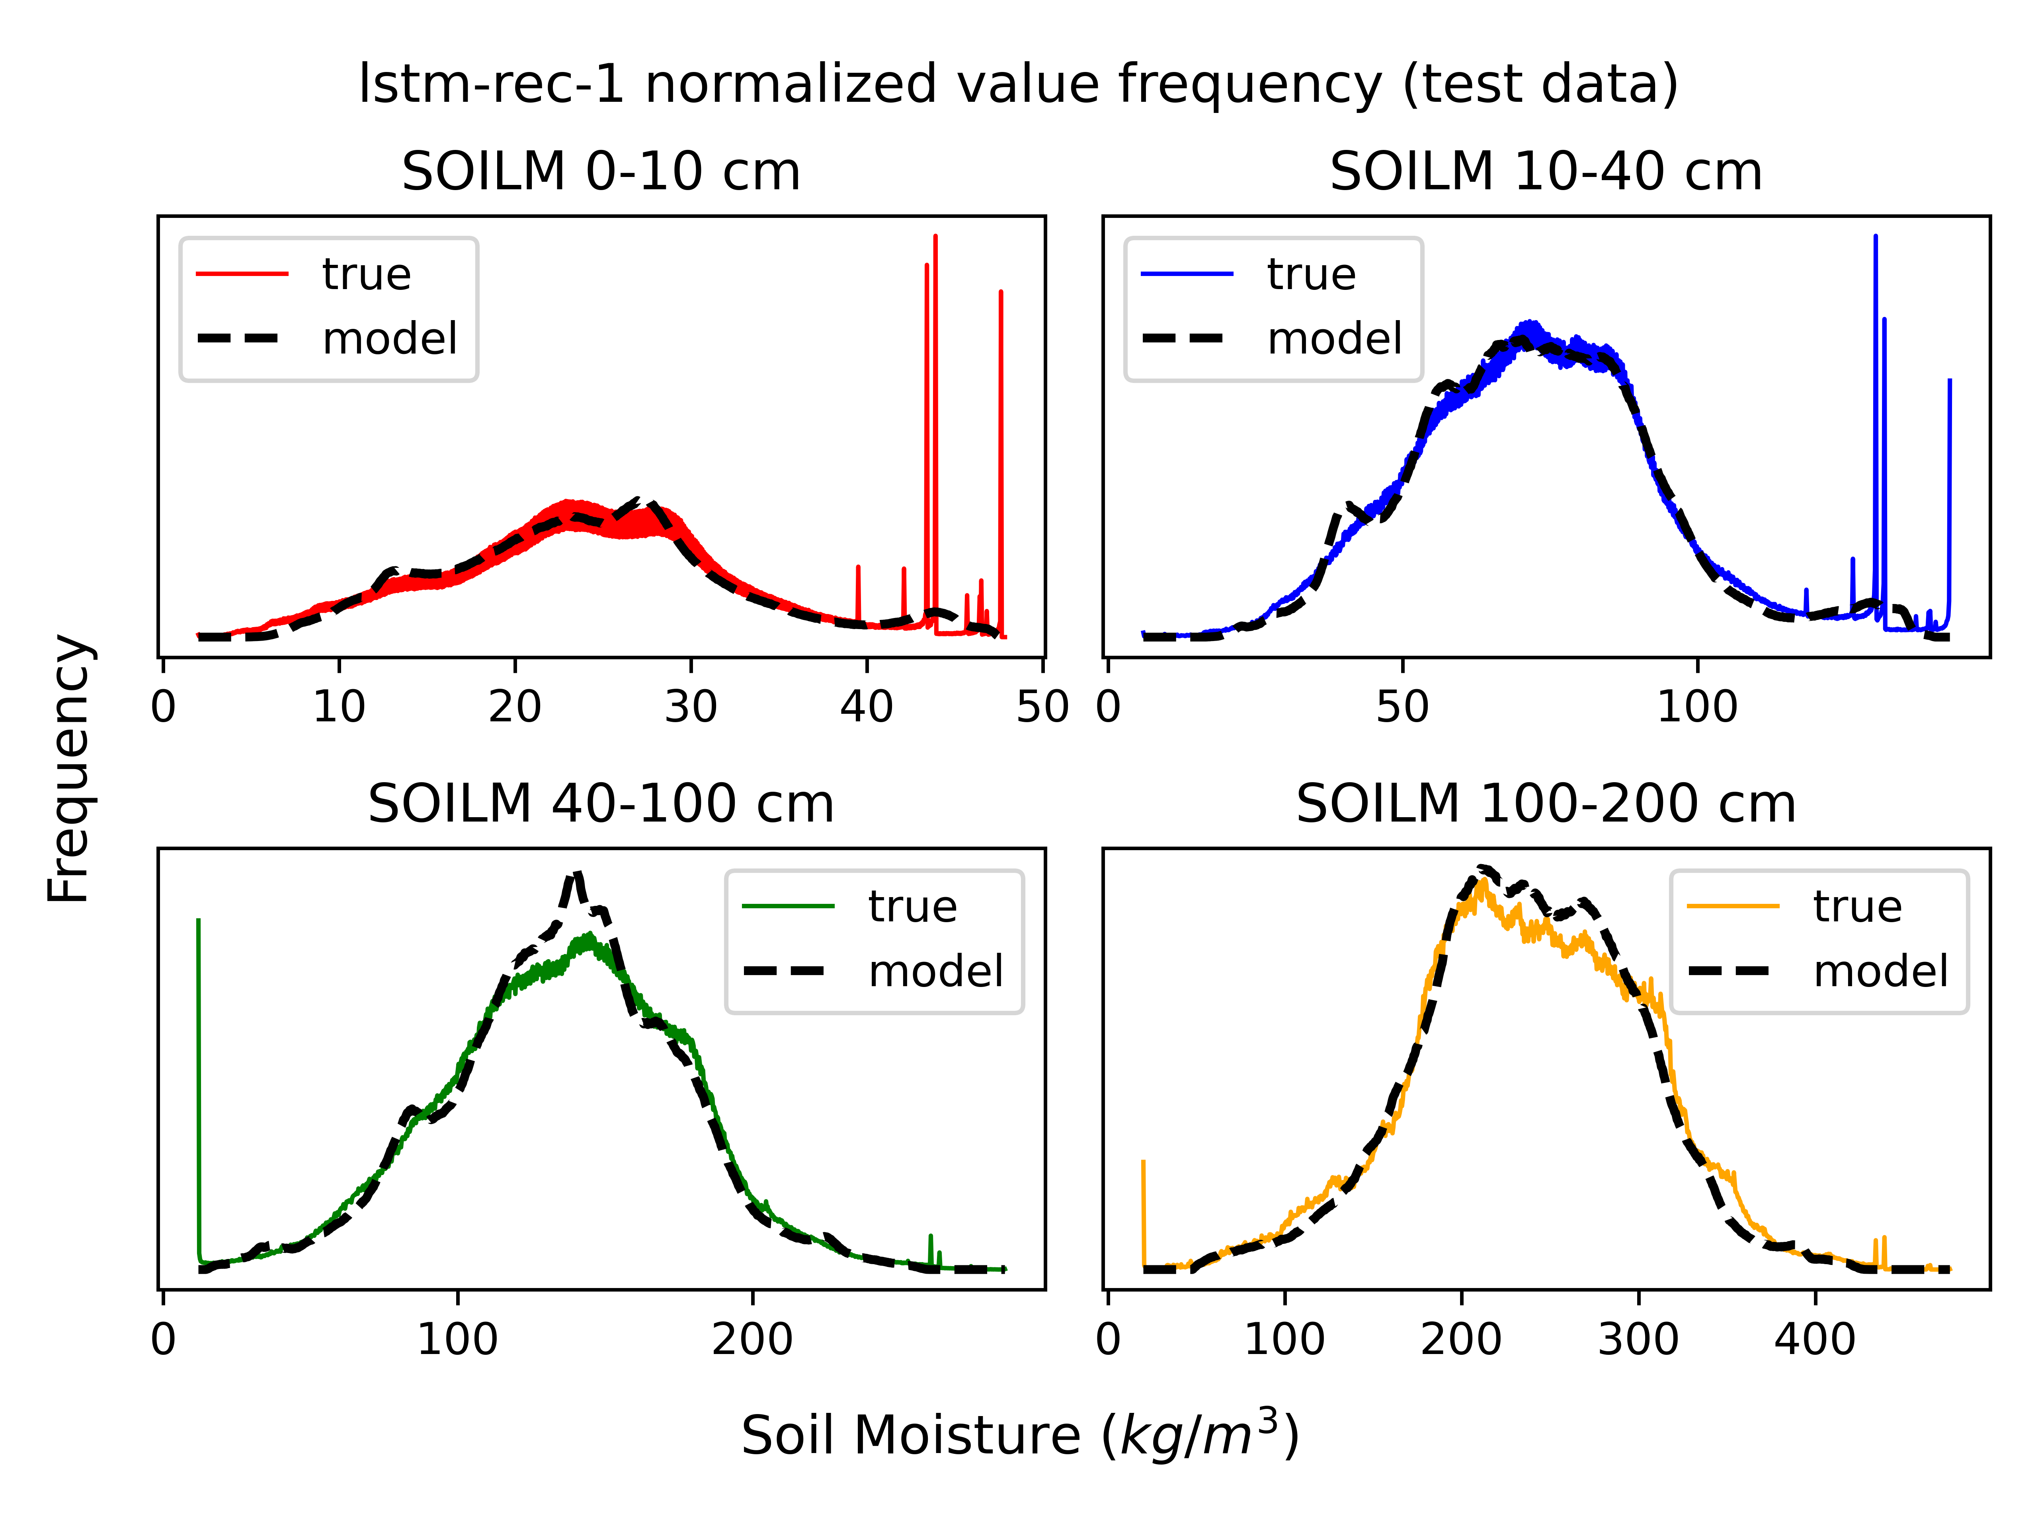
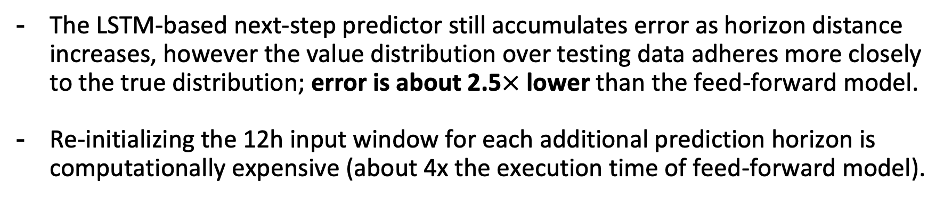
Results from LSTM next-step predictor
The LSTM-based next-step predictor still accumulates error as horizon distance increases, however the value distribution over testing data adheres more closely to the true distribution; error is about 2.5$×$ lower than the feed-forward model.
Re-initializing the 12h input window for each additional prediction horizon is computationally expensive (about 4x the execution time of feed-forward model).
Notes:
LSTM sequence inputs considerably improved value distribution matching and overall error rates
Error accumulation is still a problem due to next-step prediction.
Since a 12-hour input sequence is ingested at each predicion step, the execution time of the LSTM is significantly higher than the feed-forward mode.

Slide 12
LSTM sequence predictor
In order to mitigate compounding error, decrease execution time, and encourage learning of temporal structure, we want to output the full sequence at once.
The sequence predictor learns to encode an intermediate vector embedding E, which is provided as an input to a LSTM decoder alongside horizon features.
LSTM Sequence Predictor
E
Y_{t}
Y_{t+1}
Y_{t+H}
Encoder
Decoder
LSTM
LSTM
LSTM
LSTM
LSTM
LSTM
FF
LSTM
LSTM
LSTM
LSTM
LSTM
LSTM
[X,Y]_{t-w-1}
[X,Y]_{t-w}
[X,Y]_{t-1}
S
[X_{t},E]
[X_{t+1},E]
[X_{t+H},E]
Notes:
Predicting all error horizons at once could smooth out compounding error and incentivize more abstract learning.
LSTM sequence predictor learns to produce a latent vector representation E of the input sequence in order to provide context for the output sequence.
Latent vector is appended to each horizon feature vector, and doesn’t change as the output sequence progresses

Slide 13
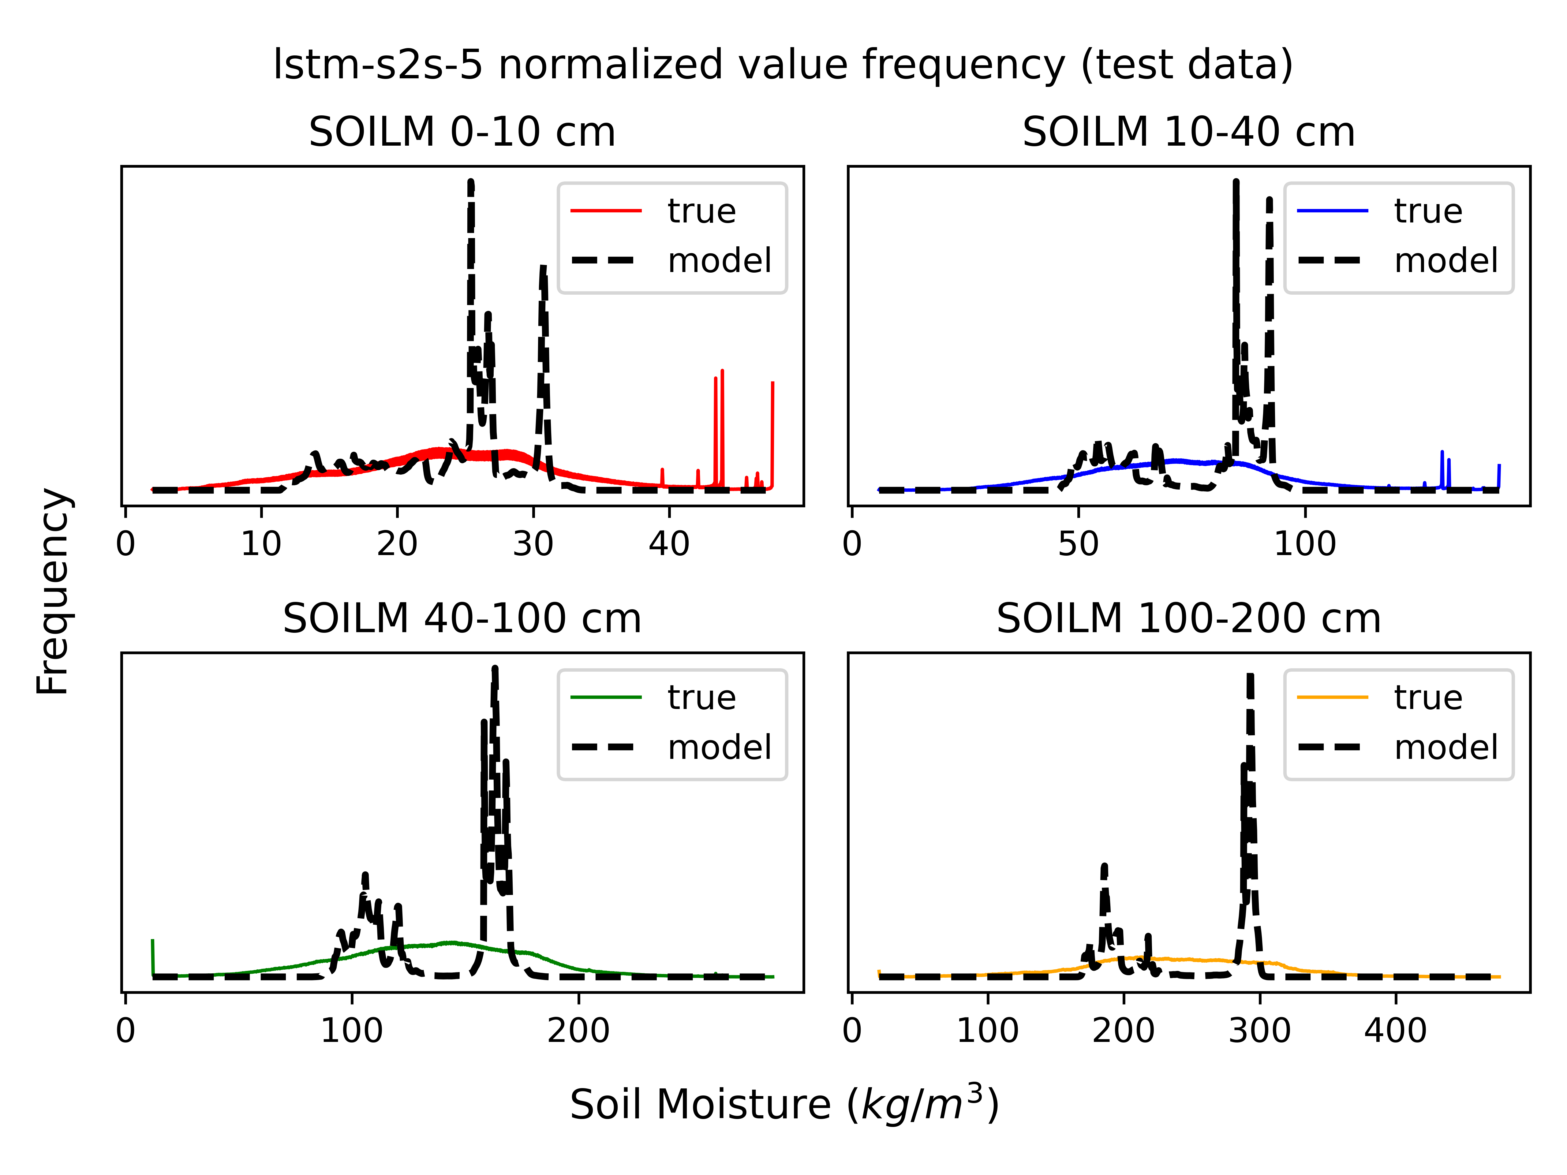
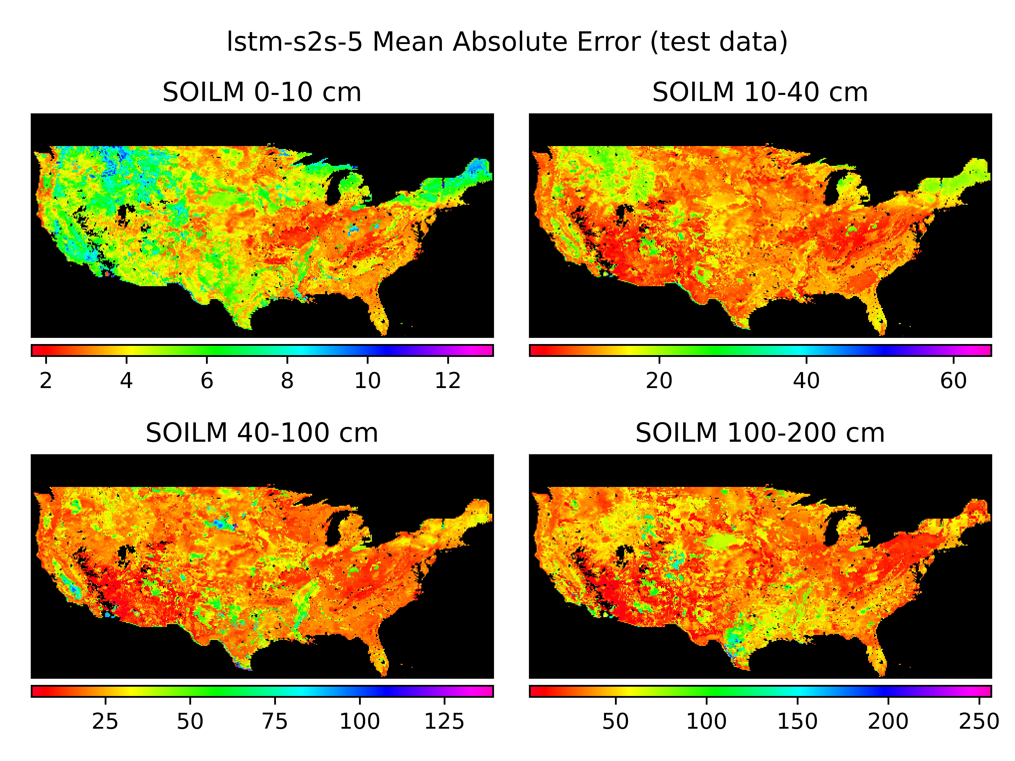
Results from LSTM sequence predictor
Over 14 training runs varying model depth, layerwise node count, and other hyperparameters, the encoder-decoder consistently struggled to stabilize.
Models generally tended to strongly favor a small subset of values, possibly because the encoded vector is copied across prediction horizons.
Notes:
Despite a large amount of crossvalidation, the LSTM sequence predictor consistently converged quickly and struggled to make accurate predictions.
Outputs strongly favored a small number of discrete values, possibly because of the output sequence’s reliance on a time-invariant context vector.

Slide 14
Deep temporal convolutional network
The deep temporal convolutional network (DeepTCN) architecture seeks to imbue the model with a notion of causality by learning a latent vector embedding E which is only exposed to past values in the input sequence.
Dilated convolutions are used to expand the receptive field of convolution outputs, and a residual connection preserves input information.
Horizon features are ingested and the full output sequence is generated at once by a series of feed-forward layers.
DeepTCN
E_{t-w-1}
E_{t-2}
E_{t-1}
Y_{t} Y_{t+1} Y_{t+H}
➕
➕
[X,Y]_{t-w-1}
[X,Y]_{t-2} [X,Y]_{t-1}
X_{t} X_{t+1} X_{t+H}
(padding)
(window)
(horizon)
Notes:
DeepTCN architecture employs a series of 1D dialated convolutions across the window feature vectors
Generates a sequence of latent vectors E corresponding to elements of the window sequence.
Supports a notion of causality by only exposing each timestep to previous timesteps’ information.
Convolution kernels have receptive fields that skip timesteps (dilation) which quickly expands the receptive area.
Residual connection between input sequence and embedded sequence preserve window information.
The full sequence of outputs is generated simultaneously by simple feed-forward layers

Slide 15
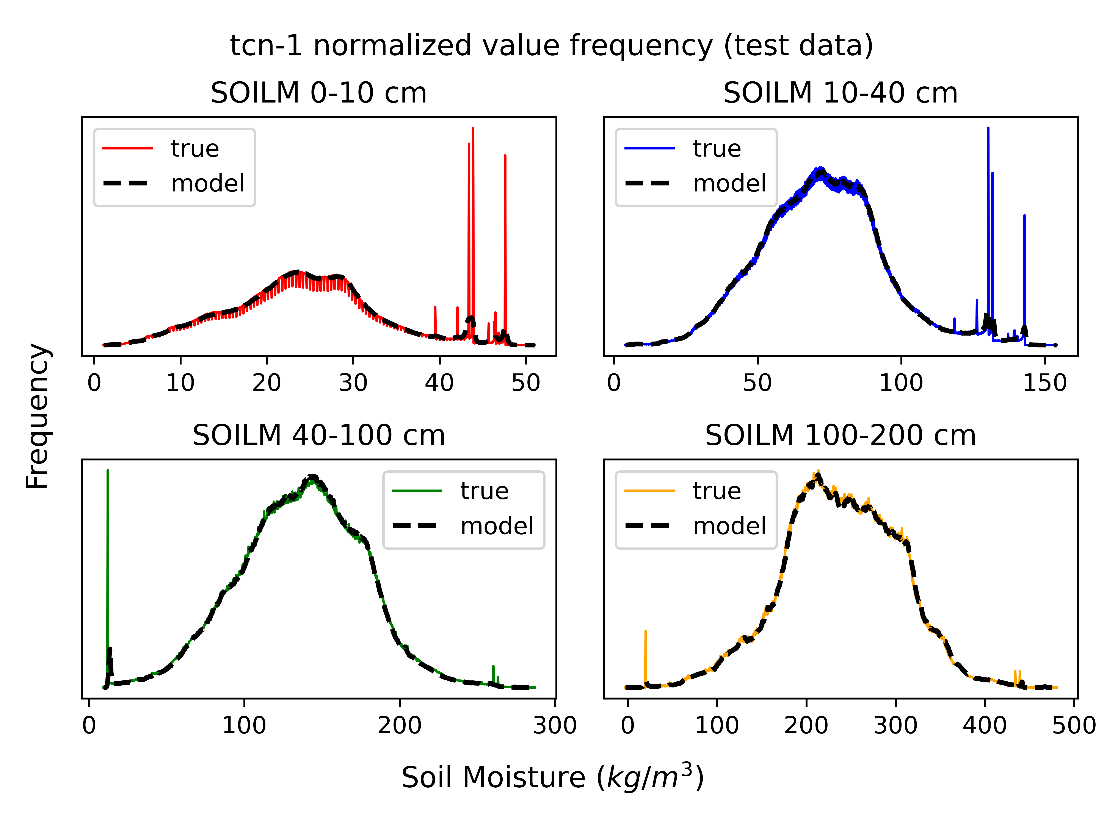
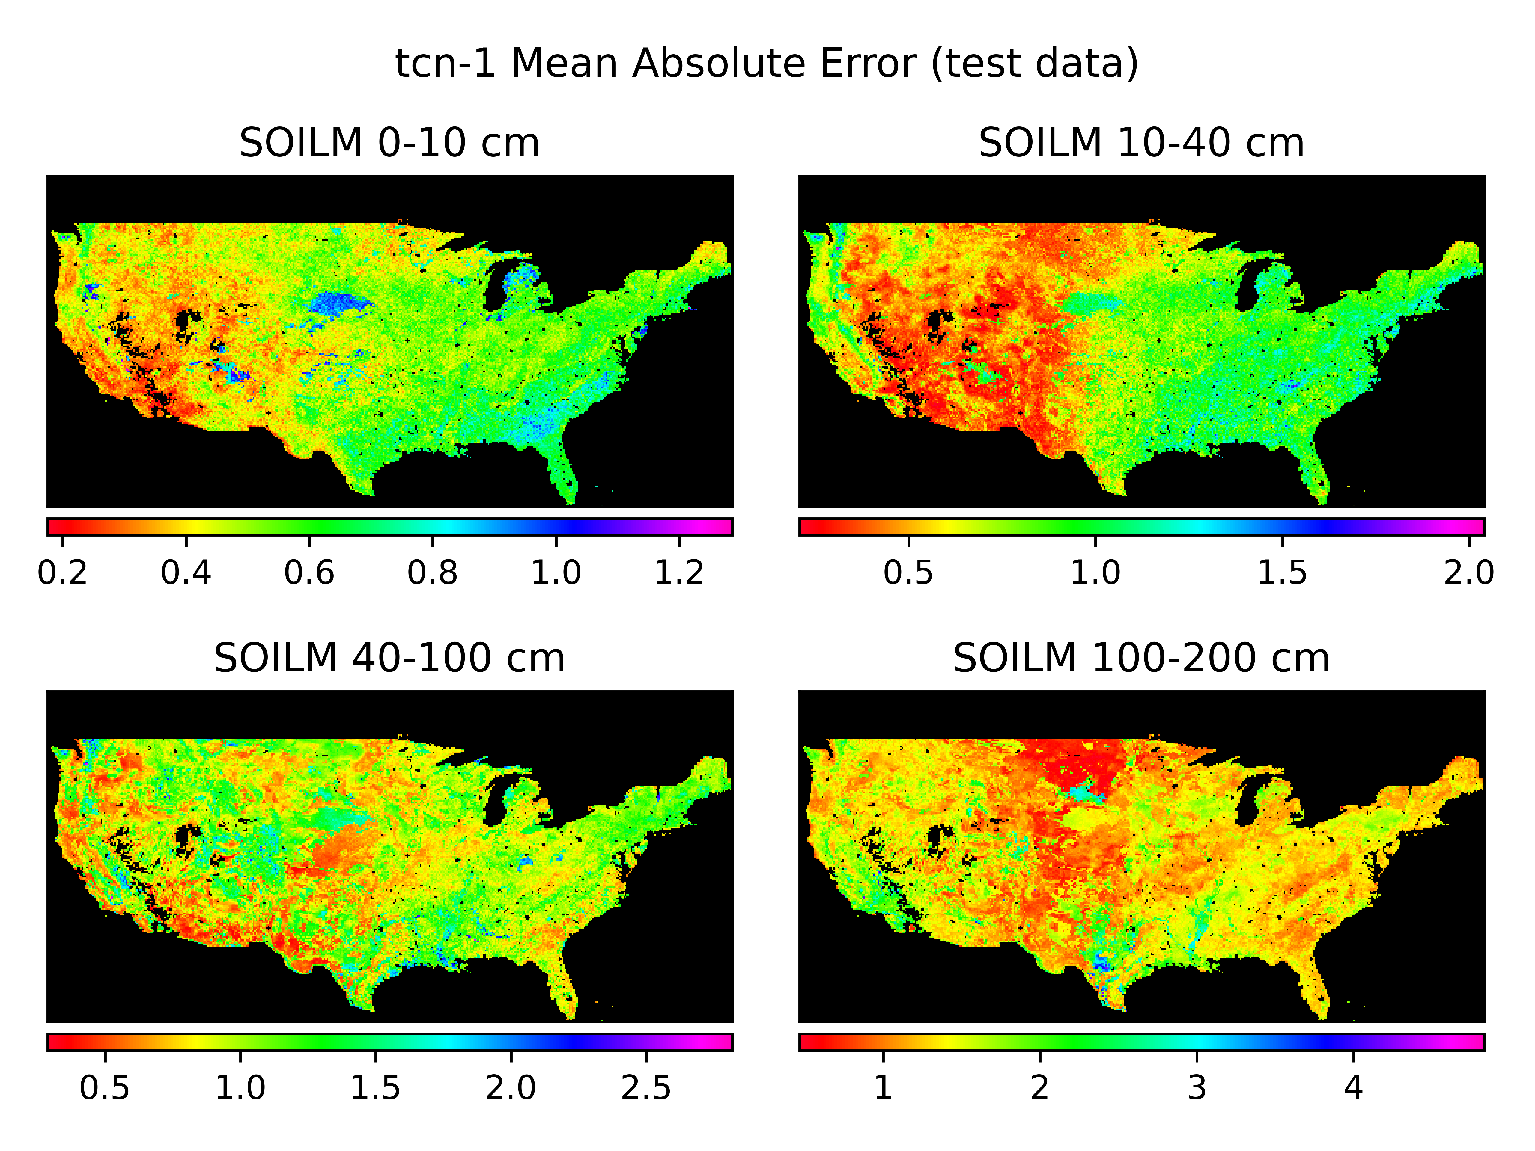
Results from DeepTCN
DeepTCN considerably outperformed all other architectures, and closely captured the training data distribution.
The highest error rates were associated with soils having relatively high sand and clay content compared to the surrounding region
Notes:
DeepTCN is the fastest architecture to execute, and boasts the lowest error rates by a significant margin.
Value histograms show that this architecture was able to capture many subtleties of the soil moisture distribution curves at each depth level.
Regionally, the highest error rates were in highly saturated areas, and in zones with soil types that are dissimilar to their surroundings.
High error in sandy soil region of Nebraska (but not Florida), and in clay-dominant areas of Texas and Mississippi River Alluvial Plane.
This seems to suggest that outputs adapt to the dominant hydrology and atmospheric forcing patterns associated with the regions where certain soil types are most commonly found.

Slide 16
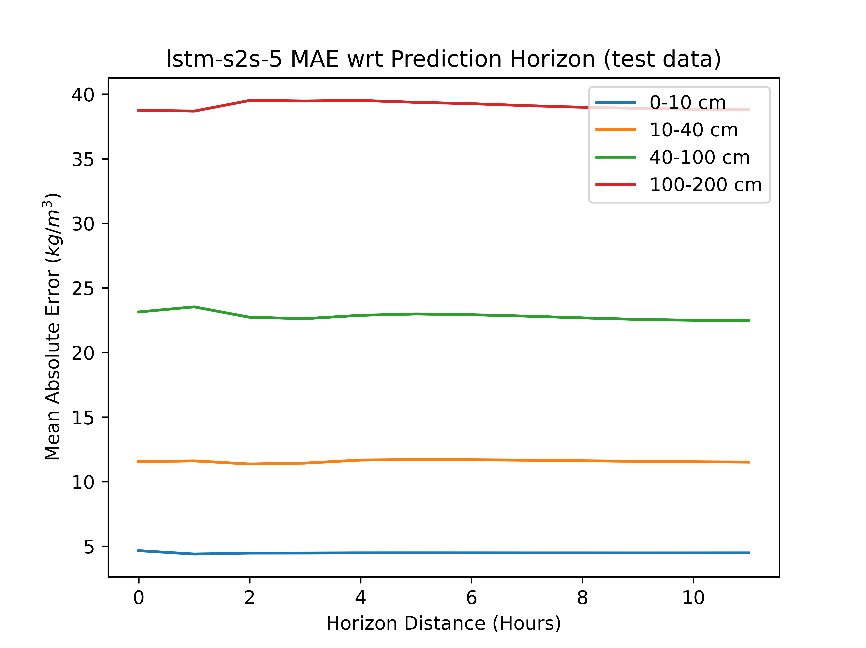
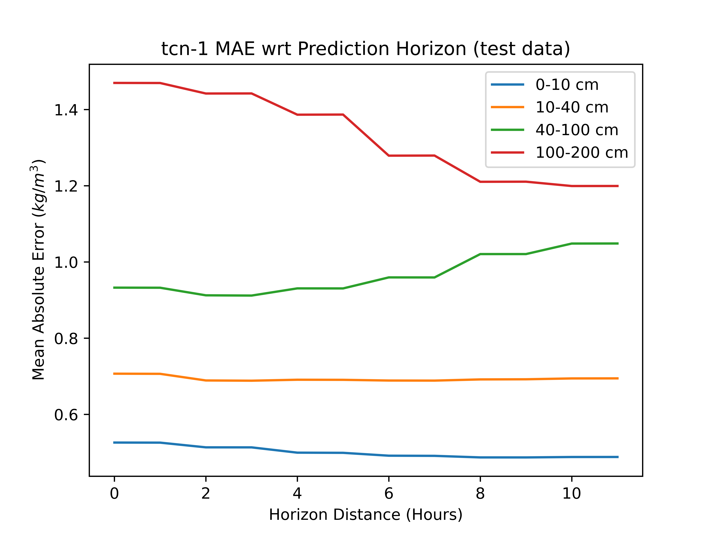
Results from DeepTCN
Both the encoder-decoder LSTM architecture and the DeepTCN have relatively stable error with respect to forecast distance, likely because they don’t explicitly accept previous predictions as valid input sequence data.
Notes:
Overall error rates across prediction horizons are much more consistent for both architectures that output the full sequence at once, compared to the next-step predictors which accumulate error by cycling in past predictions at each timestep.

Slide 17
Conclusion
Out of all of the models tested so far, the DeepTCN has the lowest error and fastest execution time for modeling short-term (12h) soil moisture dynamics.
Higher error rates generally seem to correspond to soil types that are different from the surrounding regions
Even DeepTCN outputs are still noisy at the current timescale
Overall depth-wise mean absolute error (kg/m³)
and full-grid evaluation time for one timestep with a single thread.
 | 0-10cm | 10-40cm | 40-100cm | 100-200cm | Evaluation time (s)
Feed-forward | 2.067 | 4.861 | 10.879 | 17.868 | 21.73
Next-step LSTM | 0.961 | 1.789 | 3.631 | 7.093 | 97.50
Full-sequence LSTM | 4.492 | 11.580 | 22.819 | 39.099 | 61.29
DeepTCN | 0.501 | 0.693 | 0.967 | 1.331 | 17.42
Notes:
1. Here are the over-all results at each depth level, and the total amount of time to make a 12-hour prediction at each valid point in the CONUS grid.
2. DeepTCN is the current winner in each category, however sample outputs are still too noisy at the 12-hour timescale.

Slide 18
Future work
Use feature importance metrics to reduce the total number of inputs.
Investigate parametric techniques like variational inference to stabilize the outputs and “bake in” uncertainty quantification.
Expand the size of the prediction horizon to multiple days.
Explore and compare the effectiveness of using independent models to make predictions for different depth levels, soil conditions, and seasonal processes.

Slide 19
References
[1] S. McCartney and C. Hain, “Application of NASA SPoRT-Land Information System (SPoRT-LIS) Soil Moisture Data for Drought Part 1: Foundational Understanding of LIS,” May 17, 2023. [Online]. Available: https://appliedsciences.nasa.gov/join-mission/training/english/arset-application-nasa-sport-land-information-system-sport-lis-soil
[2] Y. Xia et al., “Evaluation of multi-model simulated soil moisture in NLDAS-2,” Journal of Hydrology, vol. 512, pp. 107–125, May 2014, doi: 10.1016/j.jhydrol.2014.02.027.
[3] M. B. Ek et al., “Implementation of Noah land surface model advances in the National Centers for Environmental Prediction operational mesoscale Eta model,” Journal of Geophysical Research: Atmospheres, vol. 108, no. D22, 2003, doi: 10.1029/2002JD003296.
[4] C. Lea, R. Vidal, A. Reiter, and G. D. Hager, “Temporal Convolutional Networks: A Unified Approach to Action Segmentation.” arXiv, Aug. 29, 2016. doi: 10.48550/arXiv.1608.08242.
[5] K. E. Mitchell et al., “The multi-institution North American Land Data Assimilation System (NLDAS): Utilizing multiple GCIP products and partners in a continental distributed hydrological modeling system,” Journal of Geophysical Research: Atmospheres, vol. 109, no. D7, 2004, doi: 10.1029/2003JD003823.

